Slide 1
Continual Reinforcement Learning for Evolving
Games: Learning Across Game Updates in
Competitive Pokémon
Thomas Vroom, Dennis J.N.J. Soemers
BNAIC 2026

Slide 2
Introduction
Games have been the source of major breakthroughs in AI research:
  Chess, Go, Atari, Starcraft, Dota, ...
Modern games are often live-service: they receive frequent content updates, balance patches, seasonal events, etc.
  Keep using the same strategy? → Unpredictable performance
  Retrain after every update? → Expensive training costs
We investigate whether continual reinforcement learning can facilitate effective knowledge transfer across game updates.
  Enable agents to adapt over time, without forgetting previously learned knowledge.
Notes:
Games and game-playing agents have long been the source of many breakthroughs in AI research over the years. Think about traditional board games like Chess and Go, but also videogames like the old Atari games, Starcraft, and Dota, which all acted as key milestones in fields like search, reasoning, reinforcement learning, and deep learning.
While games have long played a key role in the research of artificial intelligence, using modern games for this purpose is significantly more challenging; one reason is that games have obviously gotten a lot more complex over the years, but another, maybe overlooked, reason is that a lot of modern games are live-service: they receive frequent content updates, balance patches, seasonal events, etc., mostly to retain player engagement. This is a big problem for the development of competitive agents, because this violates the assumption of stationarity, and it leaves us with the question of what to do with an agent when the game it was trained on is suddenly updated?

Slide 3
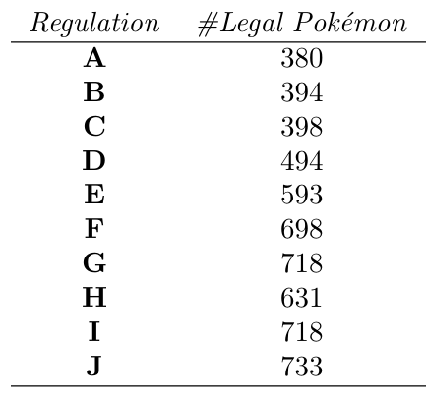
Introduction
Our domain is competitive Pokémon, also known as VGC.
A very challenging game for AI (simultaneous moves, high stochasticity, vast partial observability, etc.).
Non-stationarity through seasonal rulesets.
  Realistic example of non-stationarity.
  Clear opportunity for knowledge transfer.

Slide 4
Preliminary
Our work is based on VGC-Bench by Angliss et al. [1]
  Multi-Agent RL environment for VGC.
  Transformer-based self-play PPO agents capable of beating humans.
We start with an agent trained exclusively on regulation A, then transfer to regulation B, regulation C, etc.
  Once we leave a regulation, we never come back.
[1] Angliss et al. "VGC-Bench: Towards Mastering Diverse Team Strategies in Competitive Pokémon.“ (2025)

Slide 5
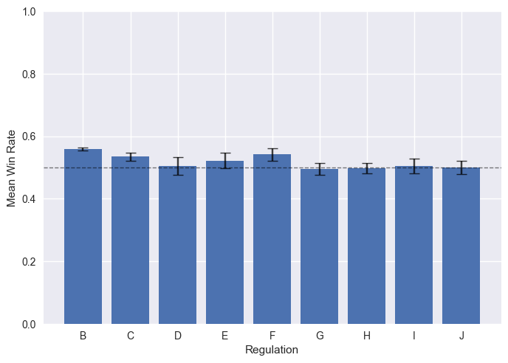
Preliminary
Are agents capable of transfer using full fine-tuning?
  1000 episodes, 3 seeds, in-distribution data, same parameters.
Notes:
Same training steps, so upper bound of expected performance.
Transfer is beneficial short-term, stagnates long term (likely loss of plasticity).

Slide 6
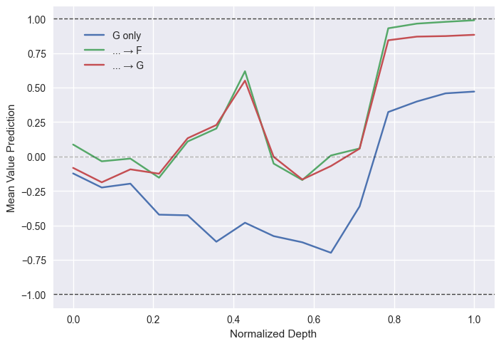
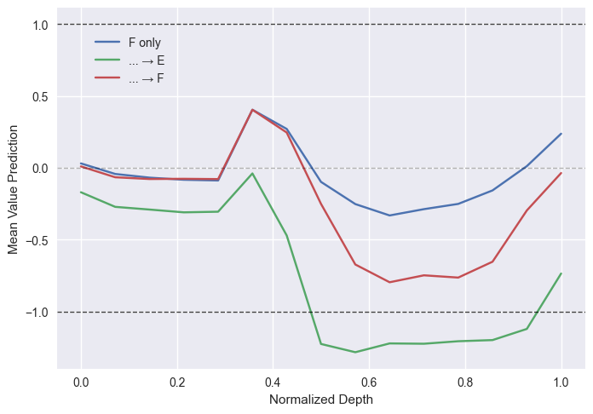
Methods
Sometimes we observe unstable behavior from the value function…
We hypothesize that this has to do with VGC-Bench’s policy architecture.

Slide 7
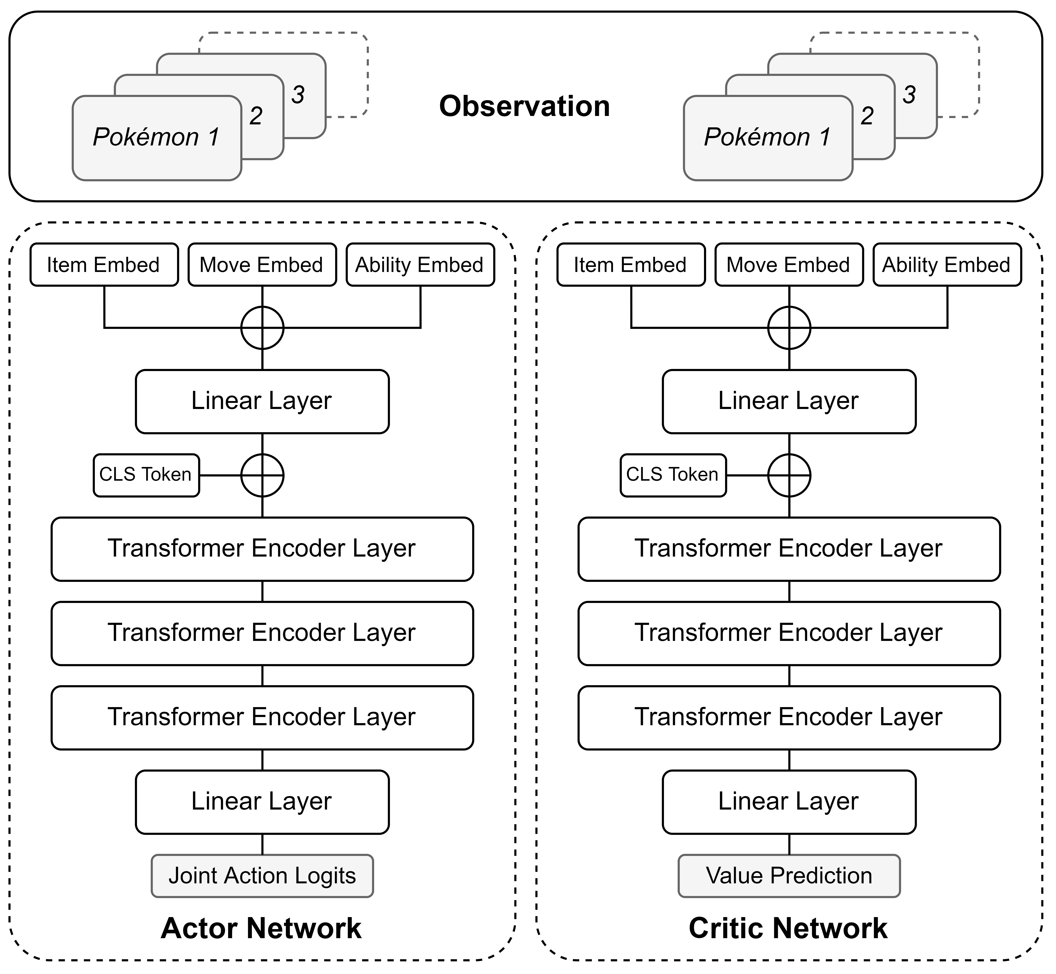
Methods
Sometimes we observe unstable behavior from the value function…
We hypothesize that this has to do with VGC-Bench’s policy architecture.

Slide 8
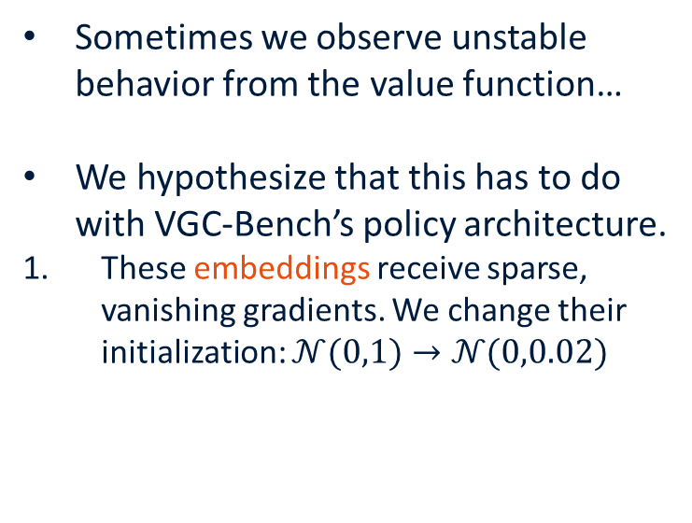
Methods
Sometimes we observe unstable behavior from the value function…
We hypothesize that this has to do with VGC-Bench’s policy architecture.
These embeddings receive sparse, vanishing gradients. We change their initialization: $𝒩(0,1)→𝒩(0,0.02)$

Slide 9
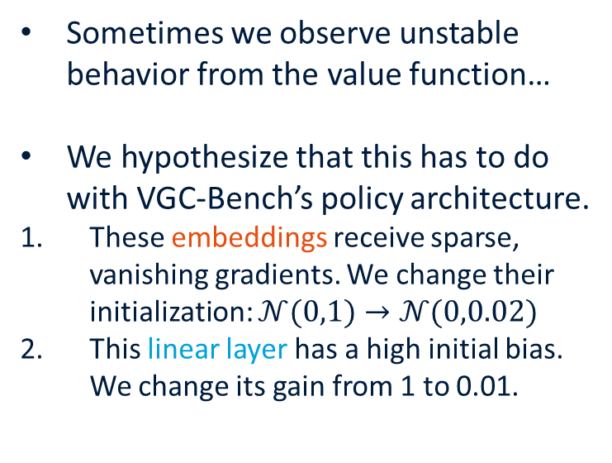
Methods
Sometimes we observe unstable behavior from the value function…
We hypothesize that this has to do with VGC-Bench’s policy architecture.
These embeddings receive sparse, vanishing gradients. We change their initialization: $𝒩(0,1)→𝒩(0,0.02)$
This linear layer has a high initial bias. We change its gain from 1 to 0.01.

Slide 10
Methods – Progressive Architecture
We identify 2 CRL methods that have good potential.
Progressive Neural Networks [2]
  Allocate separate columns of a network to different tasks, lateral connections to previous columns (no loss of plasticity).
  No prior work on the adaptation of transformer models.
[2] Rusu et al. "Progressive neural networks.“ (2016)

Slide 11
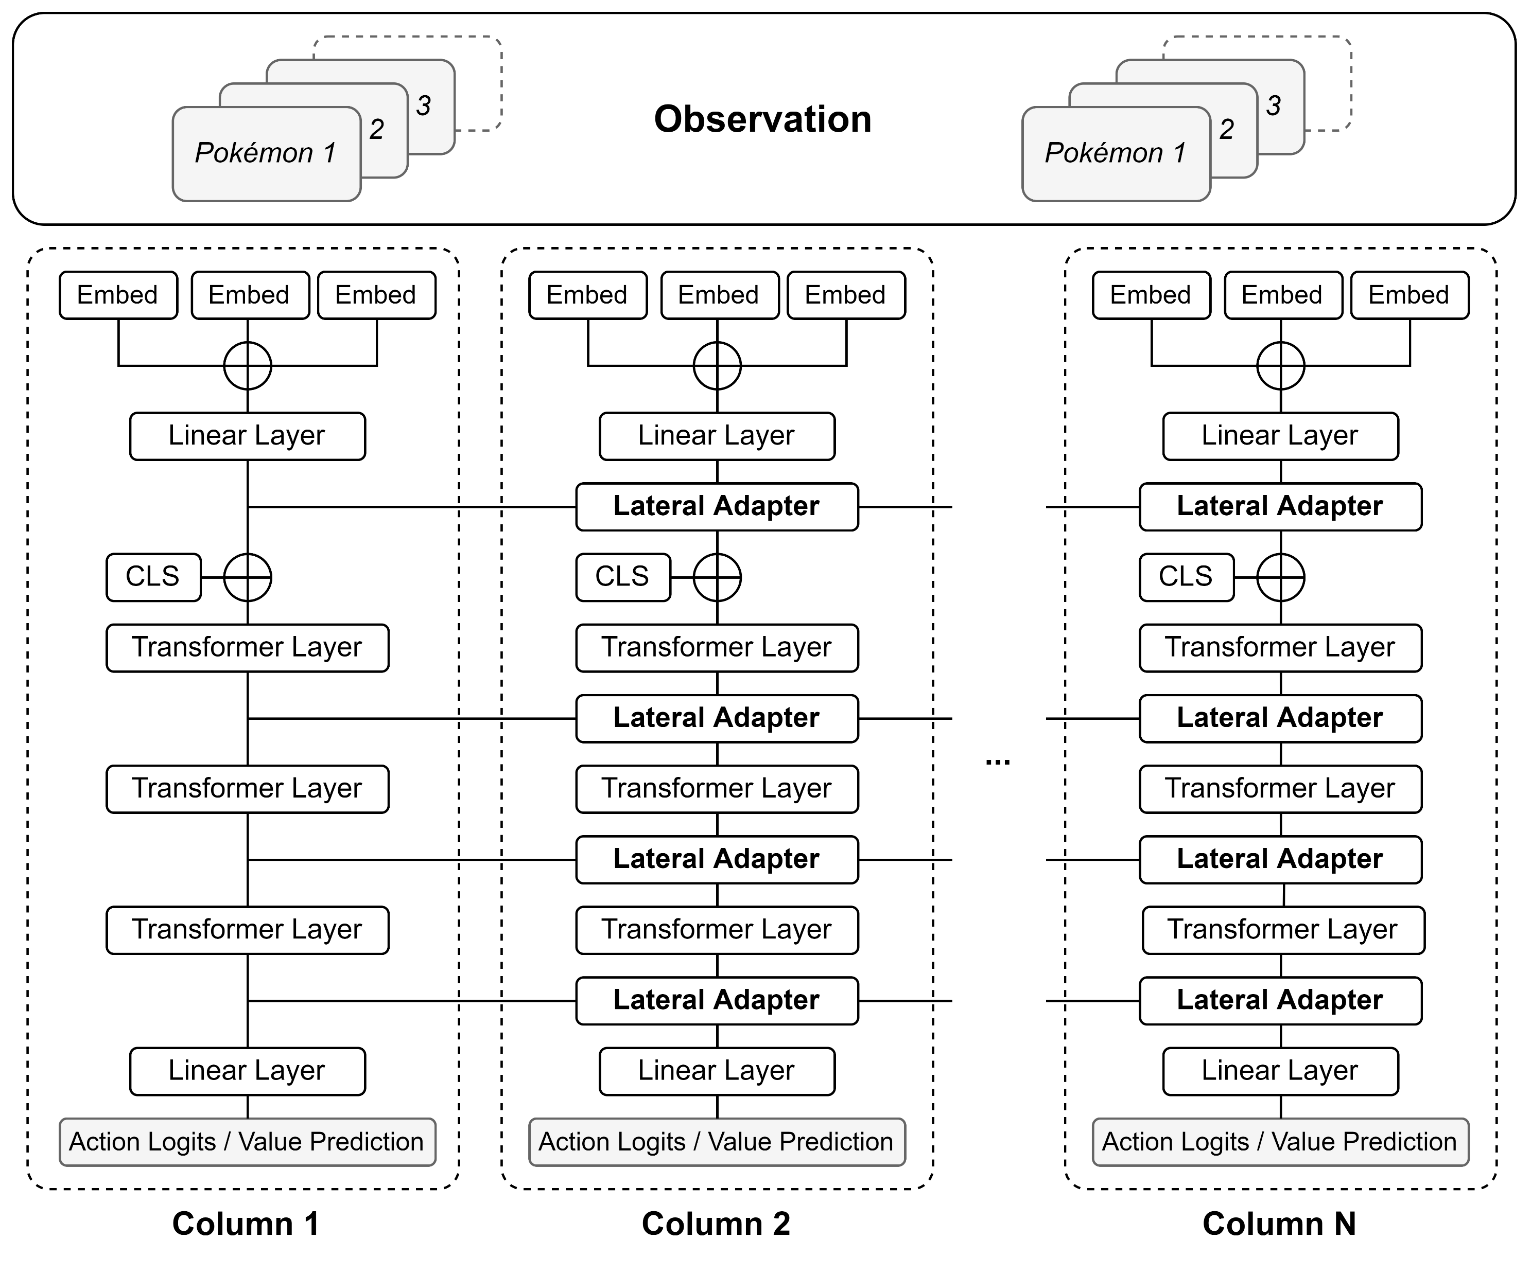
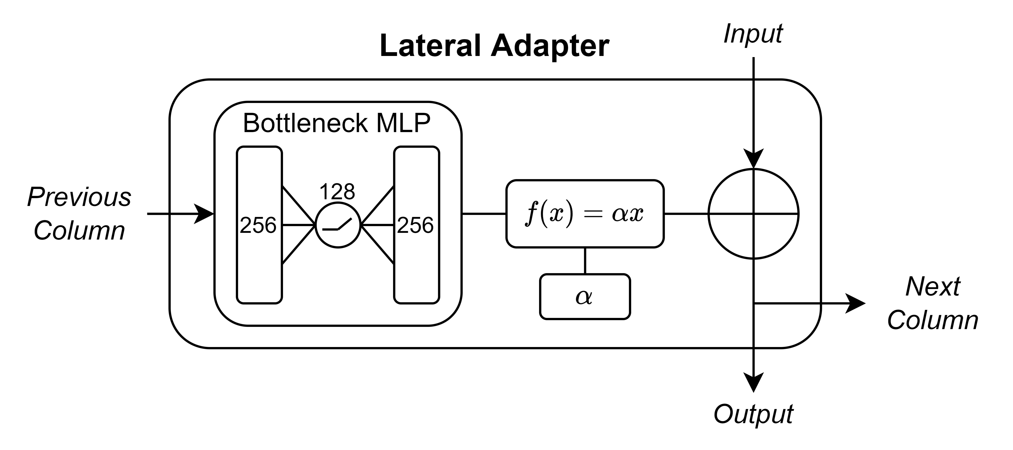
Methods – Progressive Architecture

Slide 12
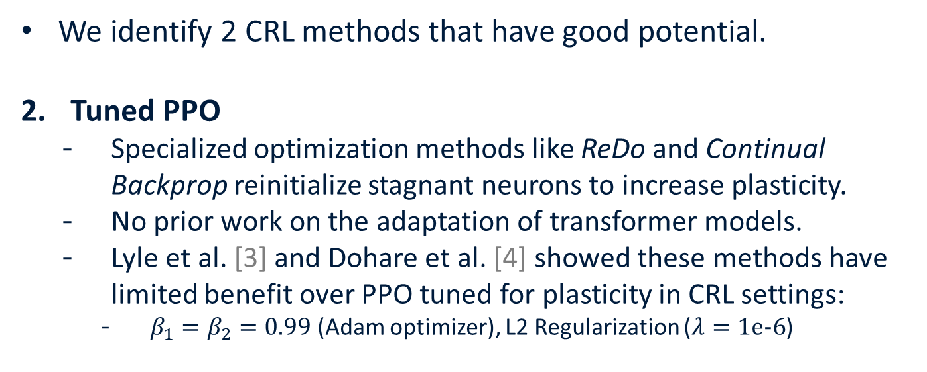
Methods – Tuned PPO
We identify 2 CRL methods that have good potential.
Tuned PPO
  Specialized optimization methods like ReDo and Continual Backprop reinitialize stagnant neurons to increase plasticity.
  No prior work on the adaptation of transformer models.
  Lyle et al. [3] and Dohare et al. [4] showed these methods have limited benefit over PPO tuned for plasticity in CRL settings:
    $β_{1}=β_{2}=0.99$ (Adam optimizer), L2 Regularization ($λ=1\text{e−6}$)
[3] Lyle et al. “Understanding plasticity in neural networks” (2023)
[4] Dohare et al. "Loss of plasticity in deep continual learning." (2024)

Slide 13
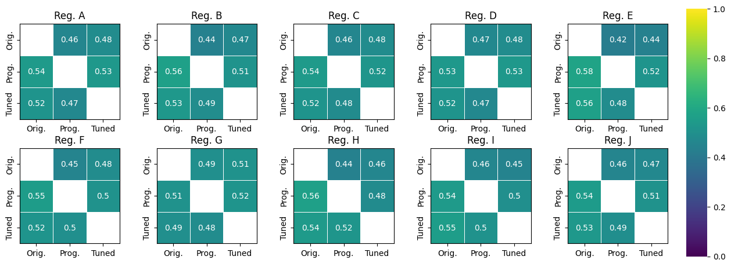
Experiments – Stationary
Mean win rate of row agent against column agent (1000 games, in-distribution data).

Slide 14
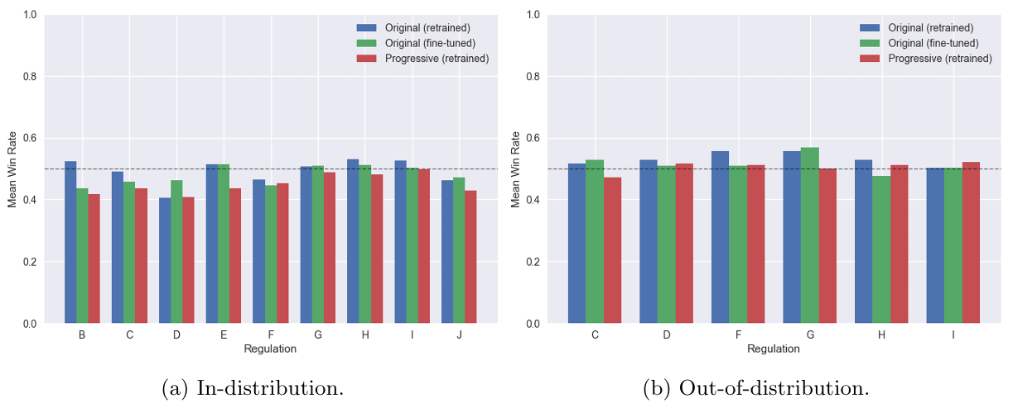
Experiments – Non-Stationary
(1000 games, progressive architecture)

Slide 15
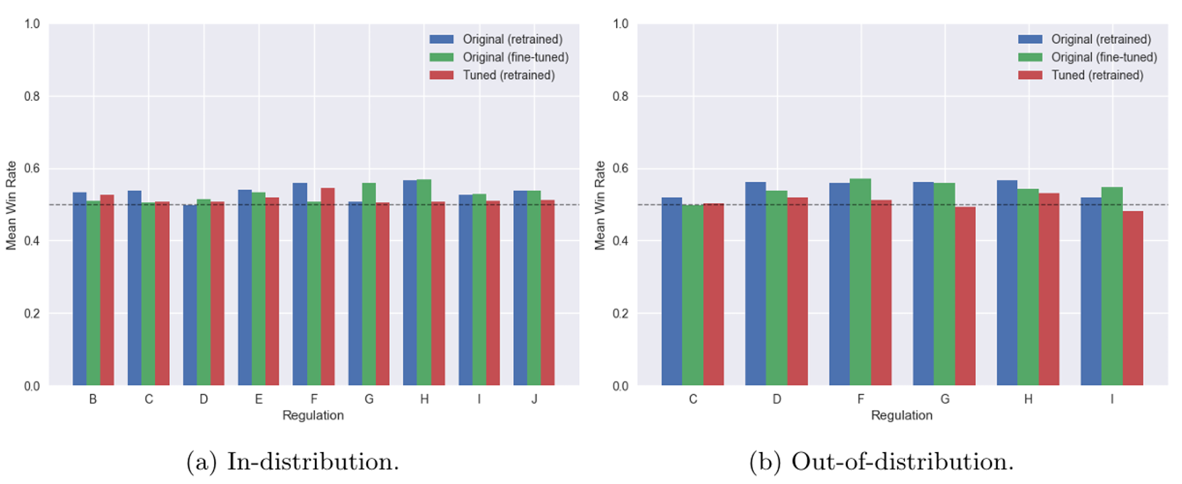
Experiments – Non-Stationary
(1000 games, tuned PPO)

Slide 16
Conclusion
Can continual reinforcement learning methods facilitate effective knowledge transfer across game updates (in VGC)?
  Tuned PPO: consistently outperforms VGC-Bench and exhibits better generalization to out-of-distribution data.
  Progressive Architecture: worse than the VGC-Bench agents, but also exhibits better generalization.
Neither agent can consistently beat its own architecture retrained.
All agents consistently improve outright performance and generalization compared to VGC-Bench!
Notes:
Retraining from scratch is still superior, but continual learning is still beneficial to RL agents in VGC!

Slide 17
Future Work
Seeing what tuned PPO achieves with only a few parameter adjustments, there is likely more on the table.
Other continual learning methods (like ReDo and Continual Backprop) are a natural next step.
Continual learning in non-stationary games is an understudied domain with great potential!
Notes:
Modern competitive games, like VGC, are an intuitive example of naturally evolving non-stationary environments with clearly defined rules, goals, and task boundaries. With continual learning aiming to solve the problem of how to allow agents to keep learning and improving after deployment, we believe that non-stationary games could serve as a natural benchmark, another “key milestone” for AI research, and help facilitate a greater understanding of how agents can remain effective in evolving environments.

Slide 18
Continual Reinforcement Learning for Evolving
Games: Learning Across Game Updates in
Competitive Pokémon
thomas.vroom@maastrichtuniversity.nl
BNAIC 2026

Slide 19
Appendix

Slide 20
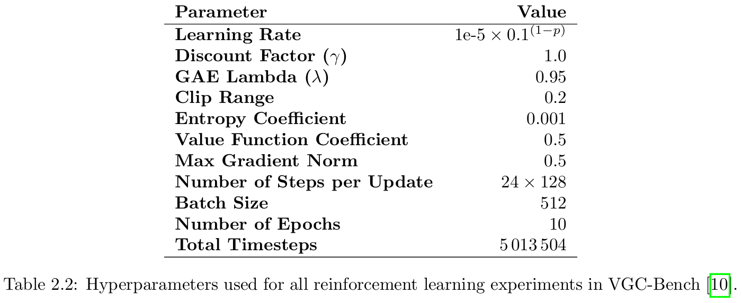
VGC-Bench Hyperparameters
[10] Angliss et al. "VGC-Bench: Towards Mastering Diverse Team Strategies in Competitive Pokémon.“ (2025)

Slide 21
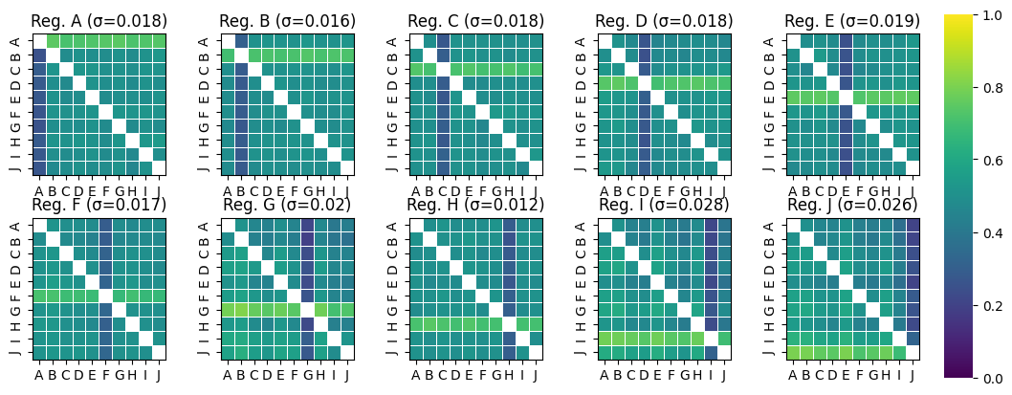
Preliminary
Are agents capable of zero-shot transfer?
  1000 episodes, 3 seeds, in-distribution data.

Slide 22
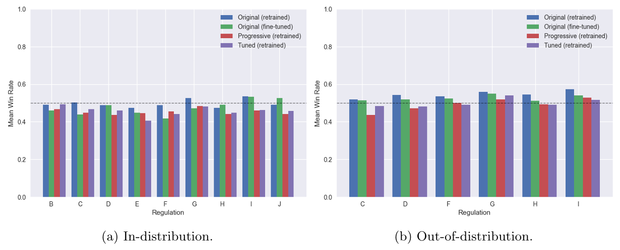
Combined Experiments
(1000 games, combined)

Slide 23
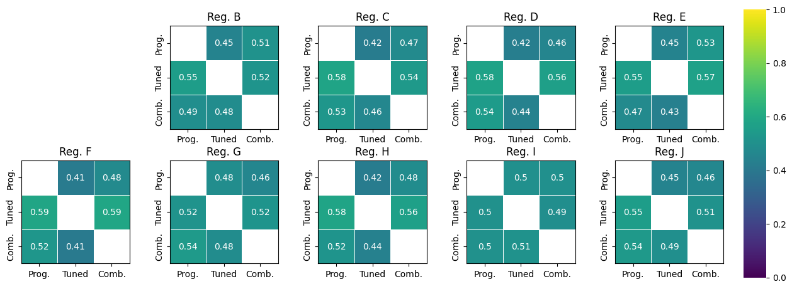
Cross-Eval Experiments
(1000 games, in-distribution data)

Slide 24
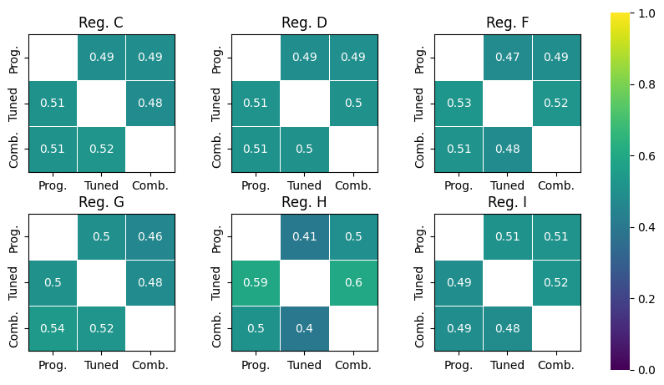
Cross-Eval Experiments
(1000 games, out-of-distribution data)

